Slide 1
INDIAN INSTITUTE OF
BANKING & FINANCE
JAIIB
MODULE (A & B)
PRINCIPLES OF BANKING
Saturday, 19 November, 2005
T M C VARADARAJAN tmc.varadarajan@scotiabank.com

Slide 2
RBI’s Major Functions
Supervisory & Regulatory
Promotional & Developmental
Refinance Activities

Slide 3
RBI’s Major Functions
Supervisory & Regulatory
Promotional & Developmental
Refinance Activities

Slide 4
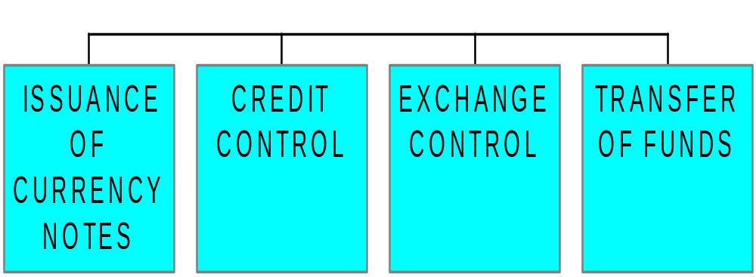
RBI’s Major Functions
SUPERVISORY & REGULATORY

Slide 5
RBI’s Major Functions
Supervisory & Regulatory
Promotional & Developmental
Refinance Activities

Slide 6
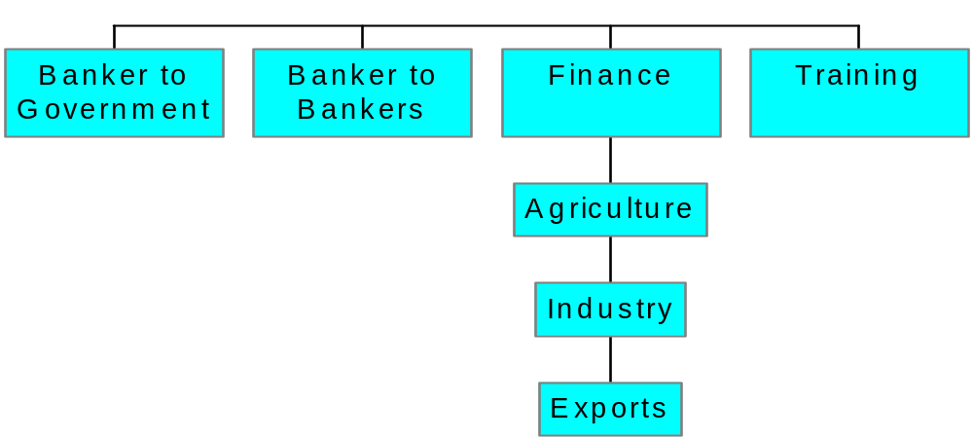
RBI’s Major Functions
PROMOTIONAL & DEVELOPMENTAL

Slide 7
RBI’s Major Functions
Supervisory & Regulatory
Promotional & Developmental
Refinance Activities

Slide 8

RBI’s Major Functions
REFINANCE ACTIVITIES

Slide 9
BANKER - CUSTOMER RELATIONSHIP
Definition
Rights & Obligations
Deposit Accounts
Loan Accounts

Slide 10
BANKER - CUSTOMER RELATIONSHIP
Definition
Rights & Obligations
Deposit Accounts
Loan Accounts

Slide 11
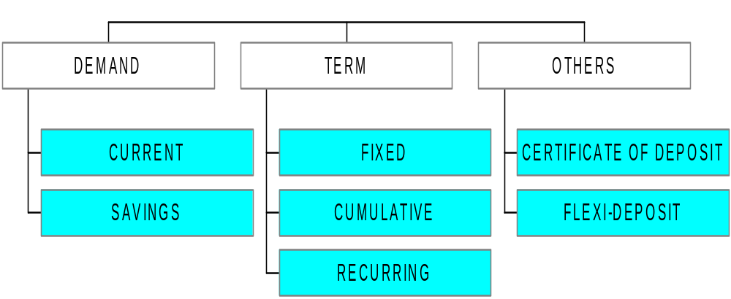
BANKER - CUSTOMER RELATIONSHIP
Deposit Accounts

Slide 12
BANKER - CUSTOMER RELATIONSHIP
Definition
Rights & Obligations
Deposit Accounts
Loan Accounts

Slide 13
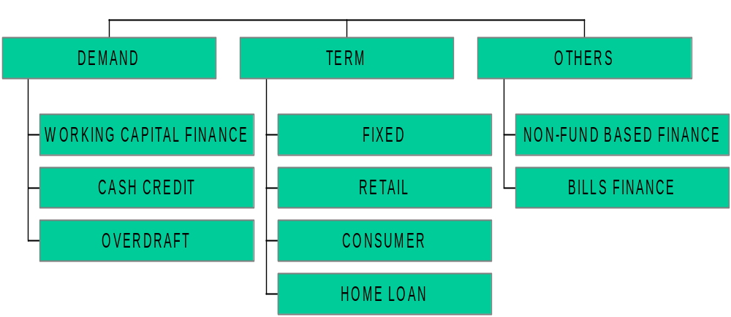
BANKER - CUSTOMER RELATIONSHIP
Loan Accounts

Slide 14
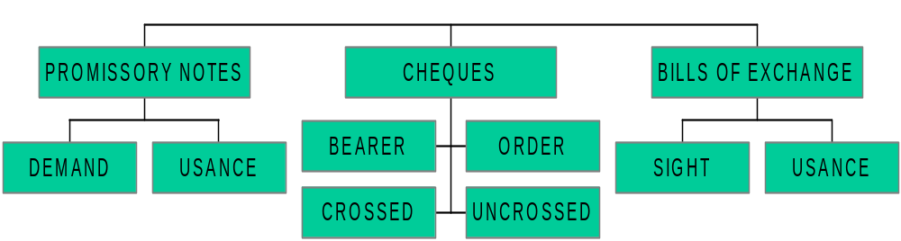
NEGOTIABLE INSTRUMENTS
TYPES

Slide 15
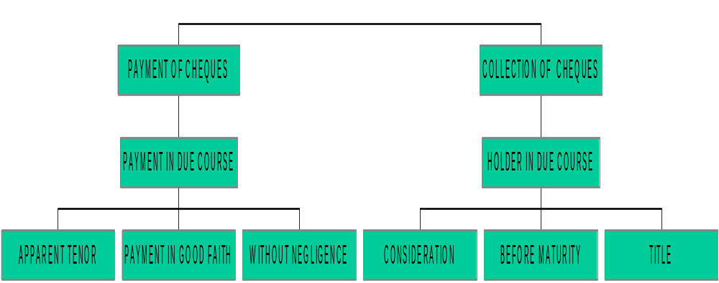
NEGOTIABLE INSTRUMENTS
BANKER’S DUTIES & RESPONSIBILITIES

Slide 16
5 C’s for Credit Appraisal
CHARACTER
CAPITAL
CAPACITY
COLLATERAL
CONDITION

Slide 17
FINANCIAL SERVICES
Objectives
Markets
Instruments
Regulatory

Slide 18
FINANCIAL SERVICES
Objectives
Markets & Instruments
Regulatory

Slide 19
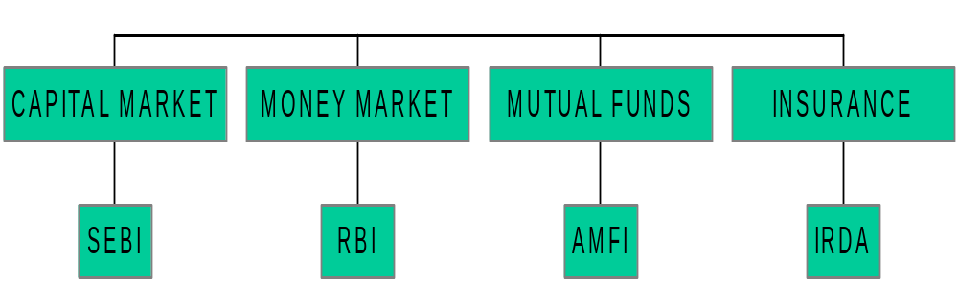
FINANCIAL SERVICES
MARKETS & INSTRUMENTS

Slide 20
Recent Developments
Banking and Technology
Basel II Accord
Universal Banking

Slide 21
THANK YOU
T M C VARADARAJAN
0022 – 2563 8965 / 5636 4214
tmc.varadarajan@scotiabank.com

